Slide 1
Final Project BDAT 1001 Part 2
Information Encoding Standards

Slide 2

Project Summary
A company is asking for us to work as consultants on a project
They have some questions that they hope we can answer and also show a demonstration of the WEB API project.

Slide 3
About Us
We are three members:
Varun Sikka (Bachelor of Science in Electronics and Communication)
Nihitha Patcha (Master of Computer Applications)
Sindhu Chakravaram (Bachelor of Science in Computer Science)

Slide 4
What is an API(Application Programming Interface)?
An API is a set of functions that allows applications to access data and interact with external software components, operating systems, or microservices.
In simpler terms, it is a software intermediary that allows two applications to talk to each other.

Slide 5
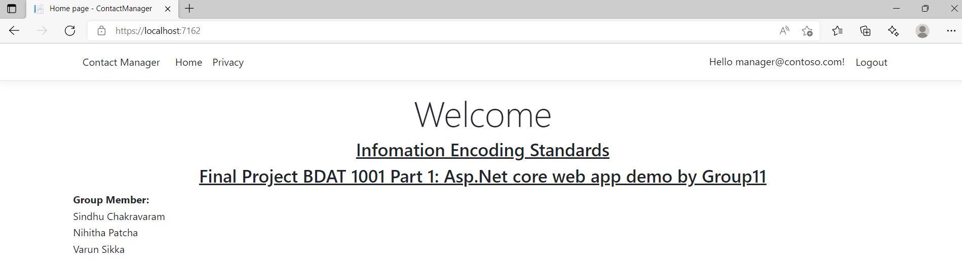
Demonstration Of Our Web API.

Slide 6
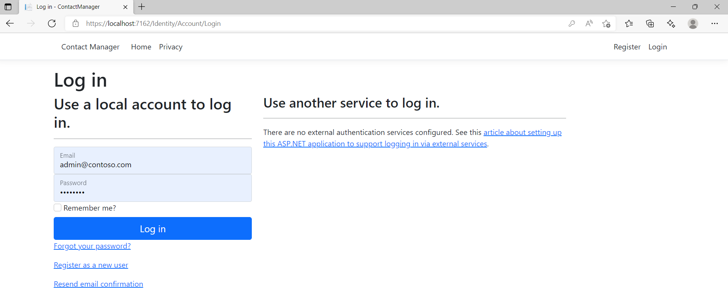

Slide 7
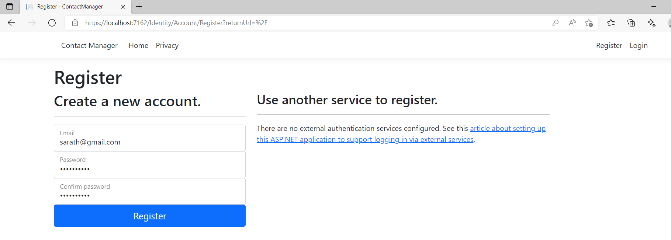
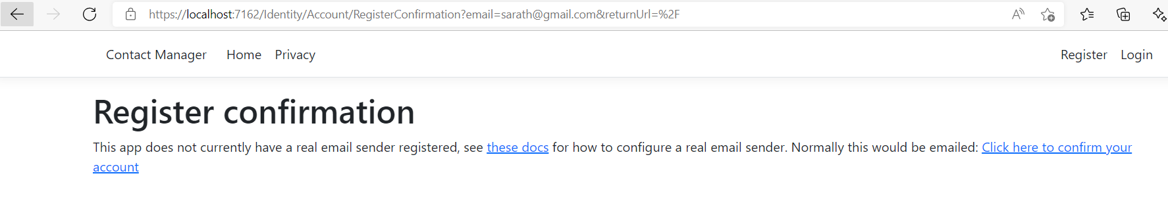

Slide 8
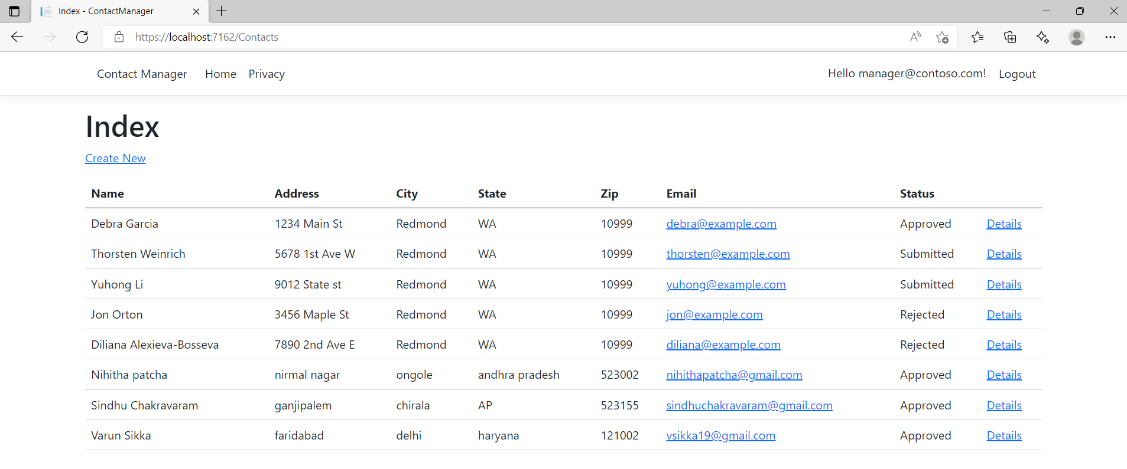

Slide 9
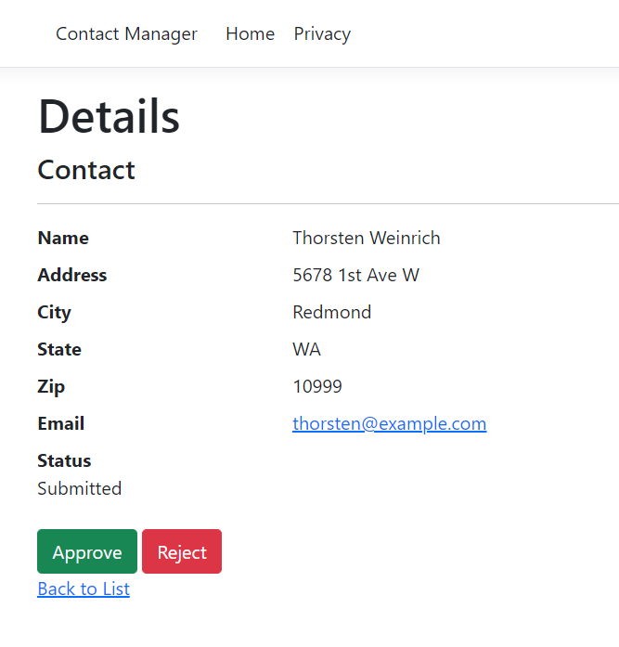
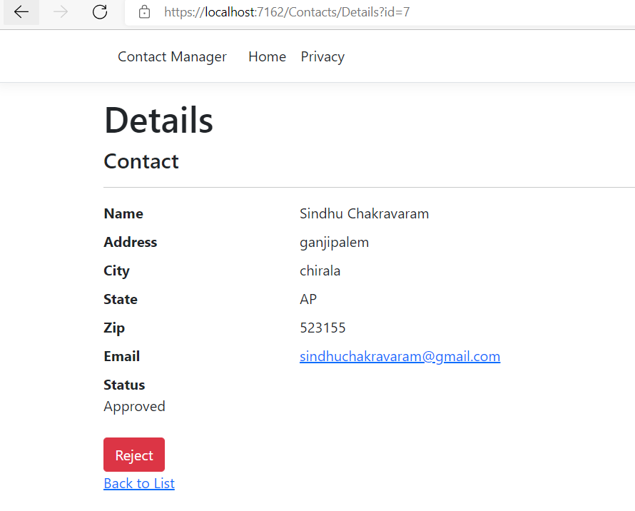
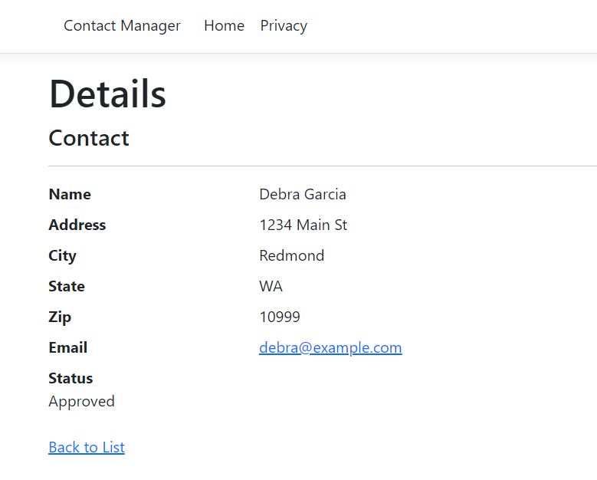

Slide 10
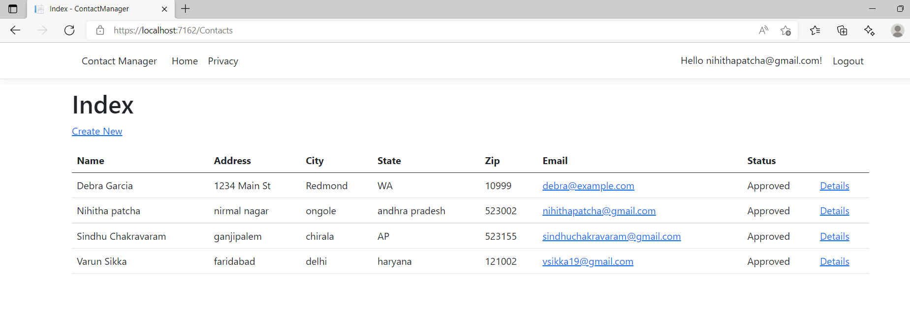

Slide 11
Questions by Client

Slide 12
How can Personal Data be transferred securely within a network?
It is very important to not only be able to share and transfer data, but also to encrypt all personal data within your network.
SFTP is an encrypted connection that requires an encrypted user ID and password to connect to a network that may have a weak security. It transfers files with the Secure Shell (SSH) connection.
The Secure Socket Shell (SSH) protocols provides encryption of data and thus it can be used to transfer personal data securely within a network .
SFTP Prevents unauthorized access to sensitive information including passwords while data is in transit

Slide 13
What security protocol is best for transferring personal files?
SFTP (Secure File Transfer Protocol) is the best protocol for transferring personal information. It is an encrypted network protocol that can have remote login to access the network.
SFTP uses a dual authentication process.
SFTP is compatible with Linux, Windows and Mac OS.

Slide 14
Can we encode and encrypt images?
Yes, images can be encoded and encrypted by using various encoding and encryption algorithm.
We can use Base64 to encode images into plain text encoding.
We can use algorithm techniques like AES (Advance Encryption Standard). Also, we can use RSA (Rivest-Shamir-Adleman)

Slide 15
A database cannot be moved from the site, and we need to be able to access it externally using a secure API. Can you explain the architecture of a secure API?
A secure API allows us to acquire data from a remote location, and REST API is the best for this.
A REST API is an application programming interface that uses a representational state transfer (REST) architectural style. The REST architectural style uses HTTP to request access and use data. This allows for interaction with RESTful web services.

Slide 16
Can you recommend a secure framework for coding an API?
The JWT (JSON Web Token) framework is very secure, which relies on tokens and only correct credentials are permitted.
ASP.NET is a popular web development framework for building web apps. It is low maintenance and required minimal coding.

Slide 17
What data interchange format should we use while transferring data between locations?
Java Script Object Notation(JSON) is a data interchange format used in order to transfer data between locations.
Another format is XML (Extensible Markup Language).
JSON is easy to understand.
These formats are fast.
They rely on key-value pairs

Slide 18
How should we store our data in our many locations?
Cloud computing is considered a good option if you want the data in multiple locations.
RDBMS and Hadoop are also useful to store data and Hadoop uses 3 locations to store data, which prevents any data loss.
You can also use a software like FileZilla to access data from multiple locations. There are also virtual machines to use i.e. VMware or Oracle VirtualBox.

Slide 19
What are the ethical concerns related to the transmission of personal data?
Confidentiality
Individuals own their own data.
Transaction Transparency
Transparent access to algorithm using their data.
Consent
Individual must be informed legally if the data needs to be used.
Privacy
All actions should be taken considering privacy of personal data.
Openness
Aggregate data must be available freely.

